Slide 1
Secure Kubernetes Native Application by OpenID with Keycloak
Kubernetes Native Application Series
Voravit L.
Senior Solution Architect
Red Hat, Thailand
Chatchai K.
Specialist Solution Architect
Red Hat, Thailand

Slide 2

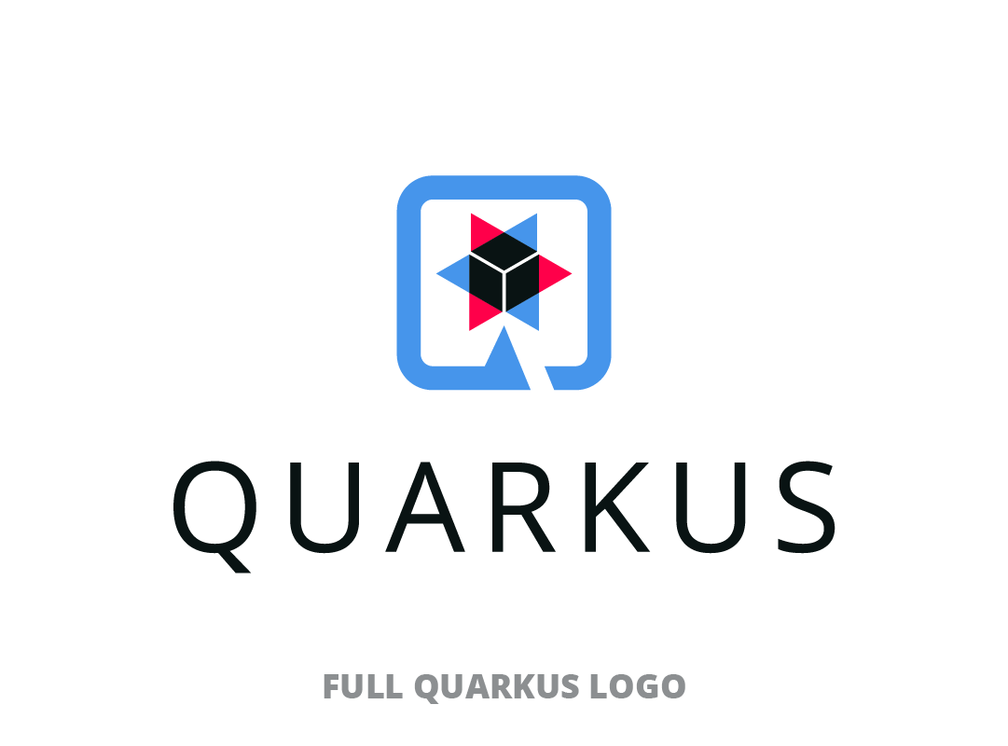

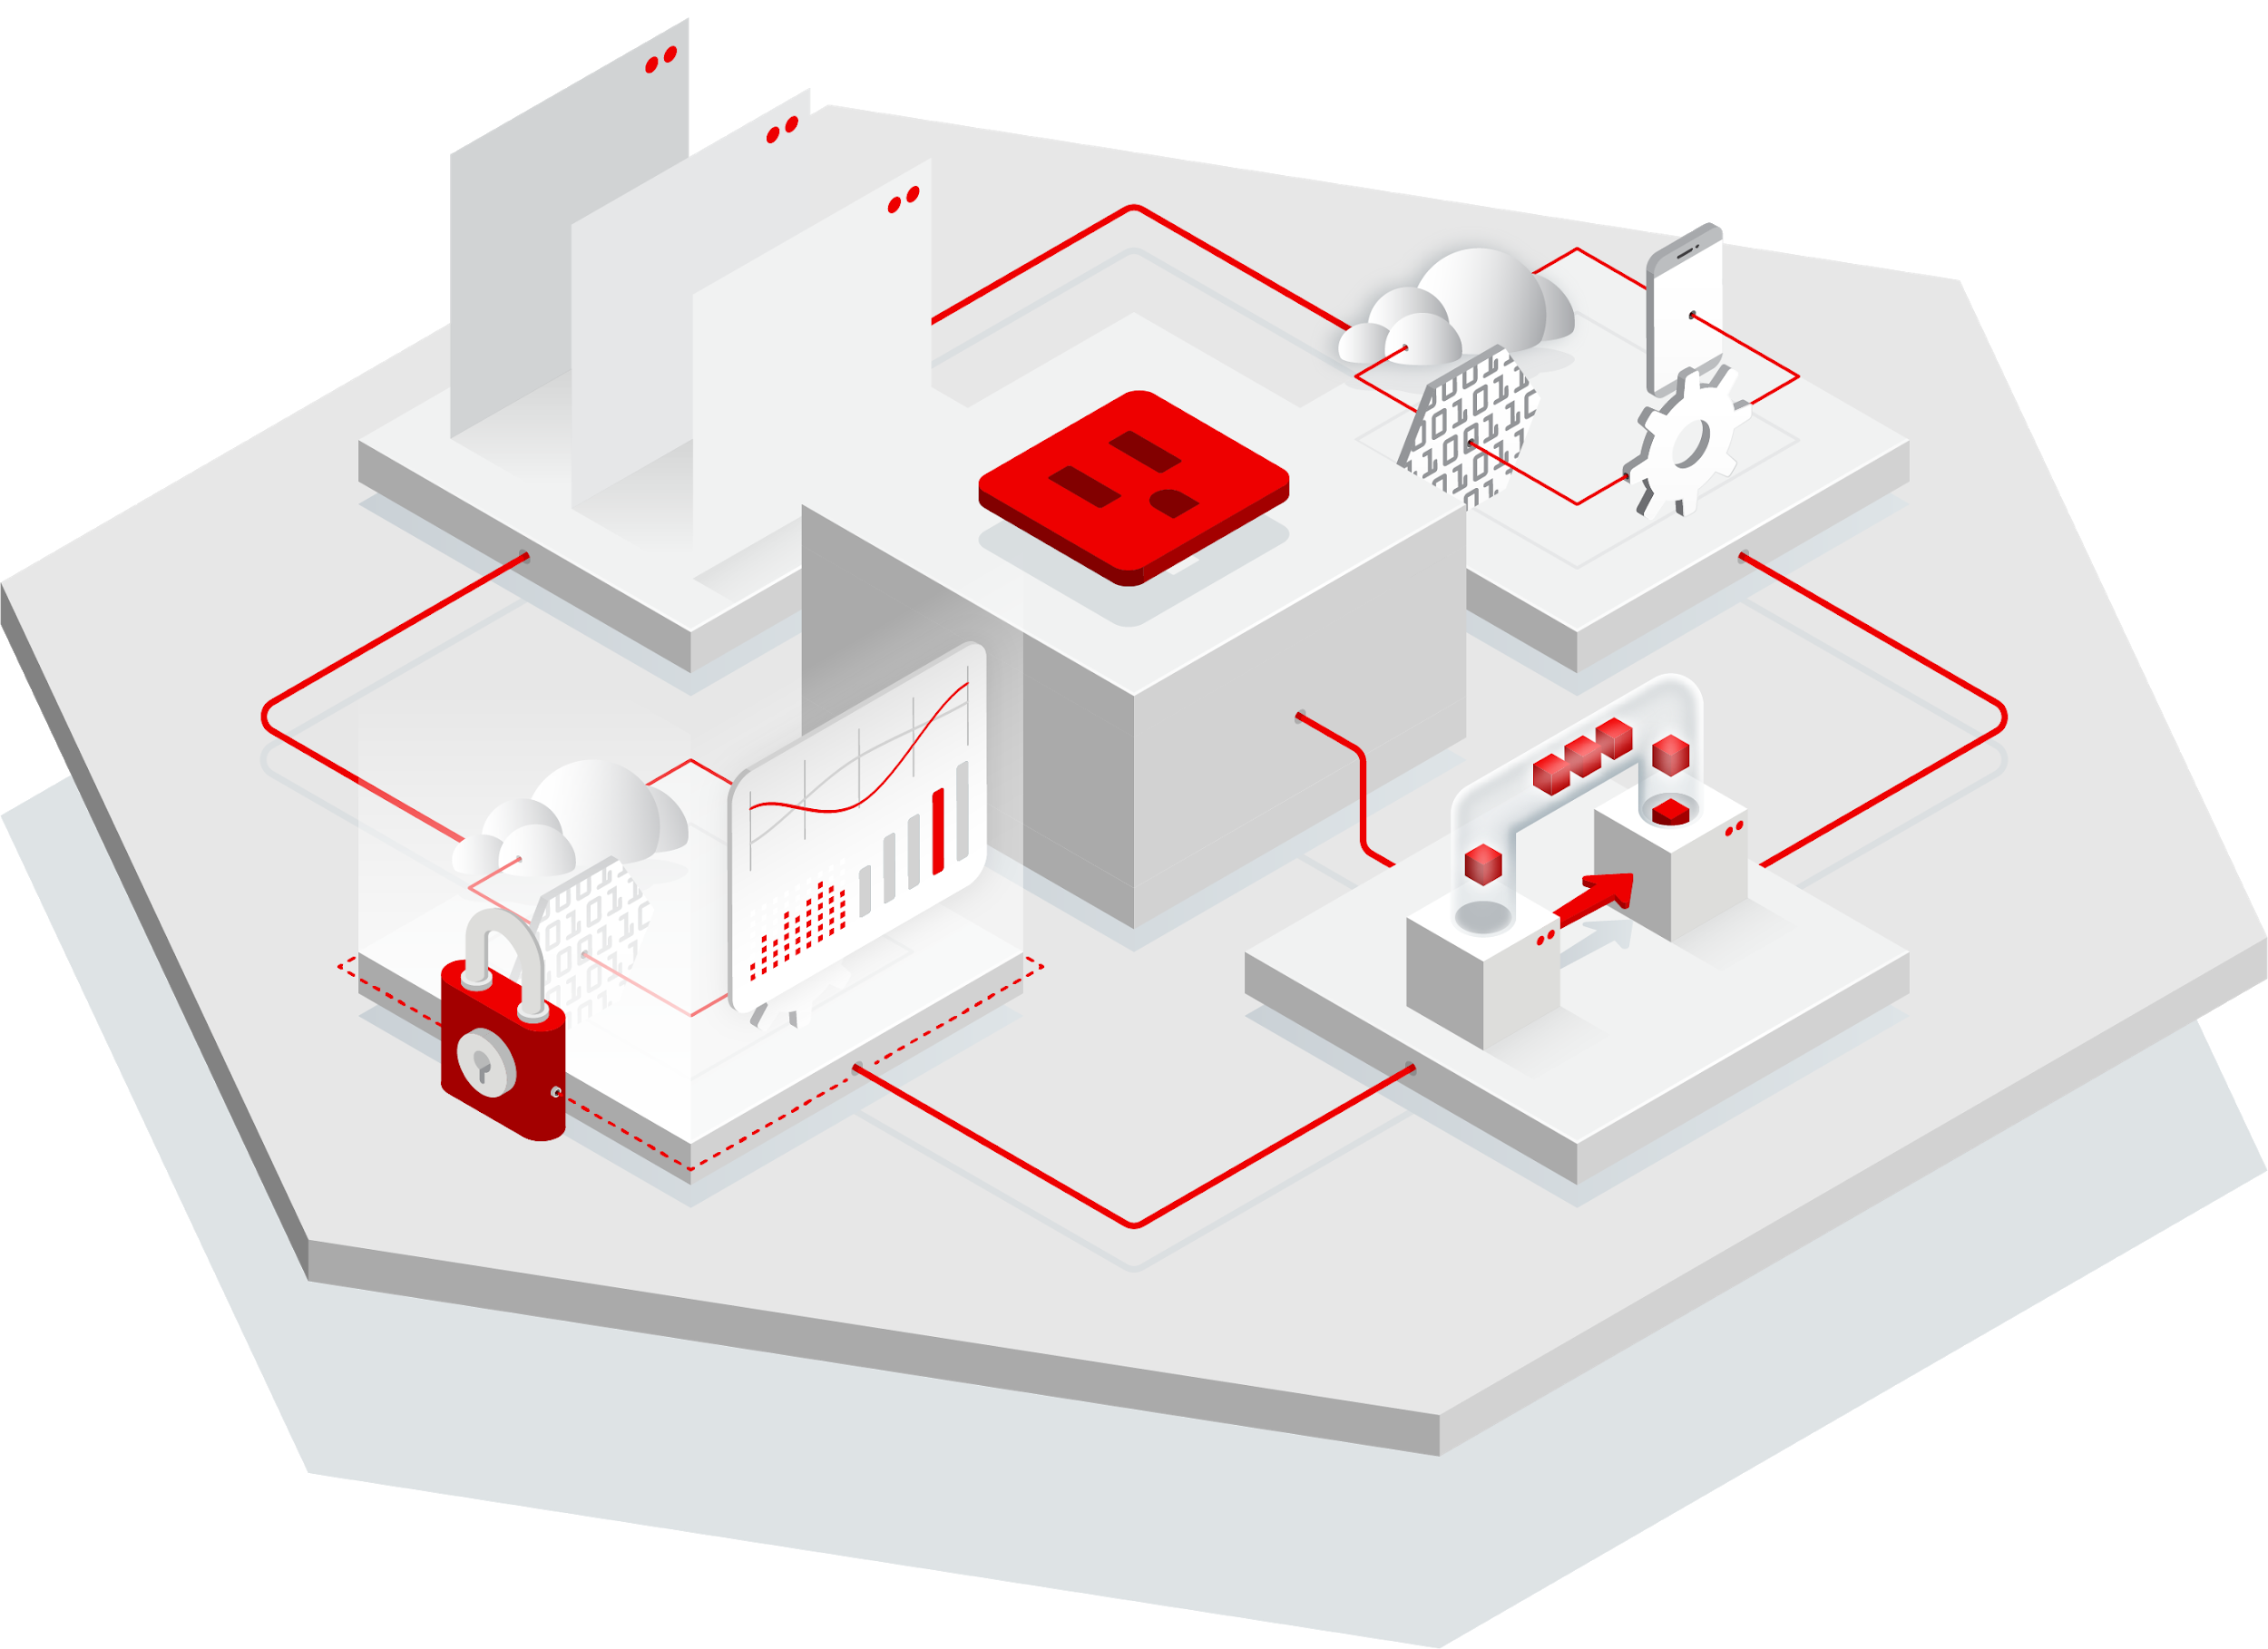

Secure Kubernetes Native Application by OpenID with Keycloak
Date & Time
Date & Time
Enhanced your microservices application with both authentication and authorization by OpenID with minimum effort by Keycloak.
Best Practices for Developing Kube- Native Application
Kubernetes Native Java for Spring Developer
Date & Time
Date & Time
Enhance your microservice on Kubernetes with Event Driven Architecture
Secure Kubernetes Native Application by OpenID with Keycloak

Slide 3



Basic Module of Web/Mobile Application
User Interface / API
Business Logic / Service
Logging/Monitoring
Security
Data Layer
Notes:
Voravit - Open with problem ….

Slide 4


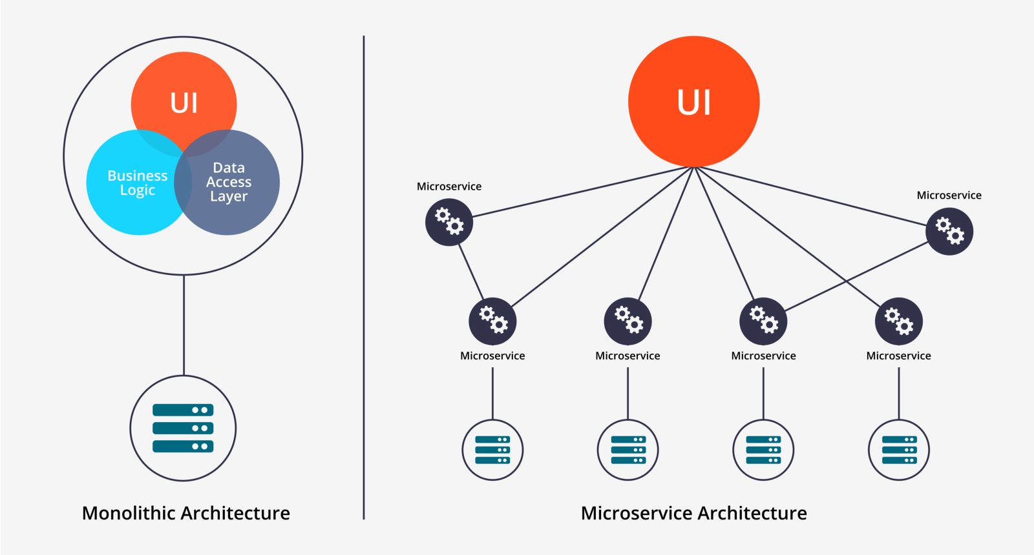
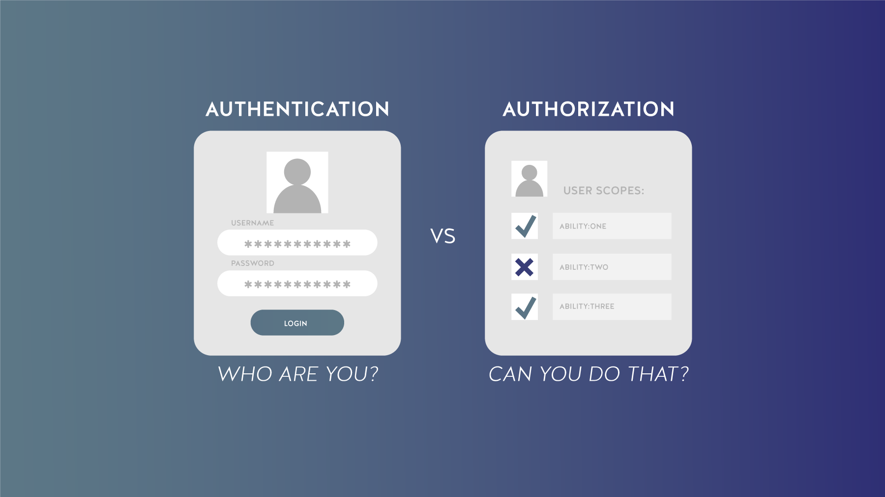
How to Secure Services?
Application Security Concerns
Transport security
TLS, mutual TLS, encryption
Can be delegated to the service mesh
Origin security
User wishes to login to an application
Identity and Access management
Central authentication and authorization
Notes:
Security = Authentication / Authorization & Audit

Slide 5


How to Secure (Micro)Services?

Slide 6
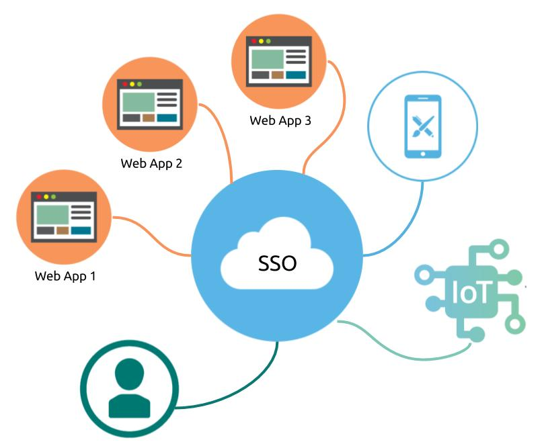
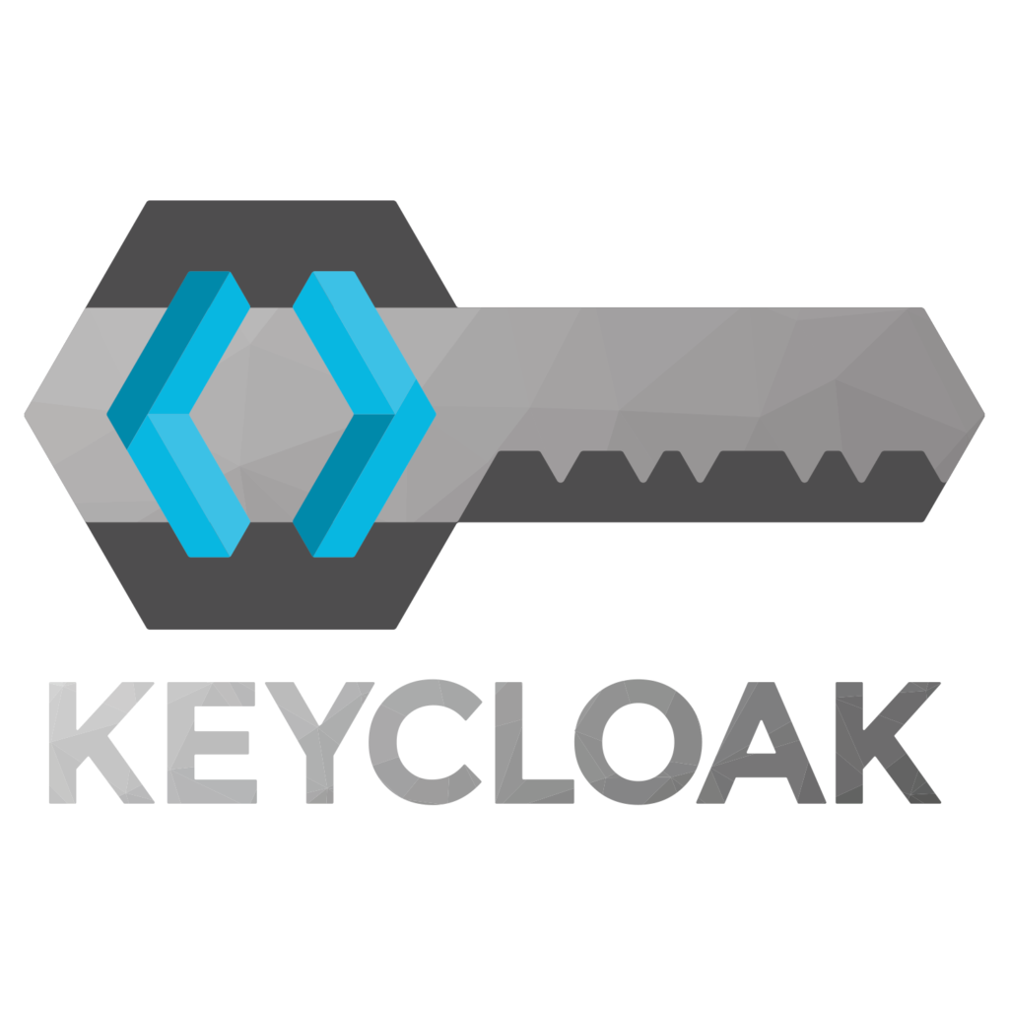
SSO with Keycloak!

Slide 7
What is Keycloak?

Slide 8

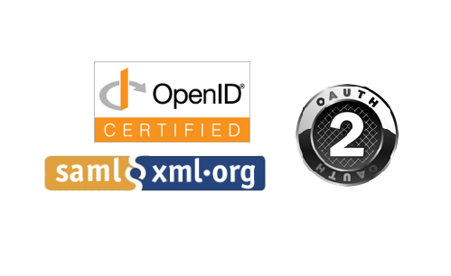
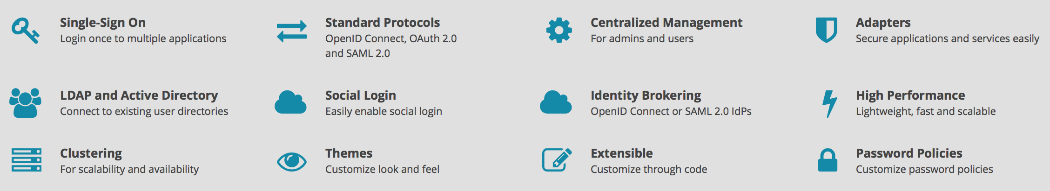
High-Level Architecture & Features
What is it?
Keycloak project
Open source access & identity manager
Identity Brokering
User Federation with LDAP-based directory services
Client libraries for Java EE, MicroProfile, Spring, Node.js, & more
Event auditing
RH-SSO Component Details: https://access.redhat.com/articles/2342881
RH-SSO Supported Configurations: https://access.redhat.com/articles/2342861

Slide 9
Keycloak Concepts
Core Concepts
Authentication
Identifying & validating a user
Authorization
Granting access to a resource to a user
Clients
Entities that can request authentication for a user
Often is an application acting on behalf of a user but still needs to authenticate itself to a downstream service
Session
Created upon login
Contains information about the user
When logged in, which applications participated in the authentication, etc
Admins & users can view session information

Slide 10
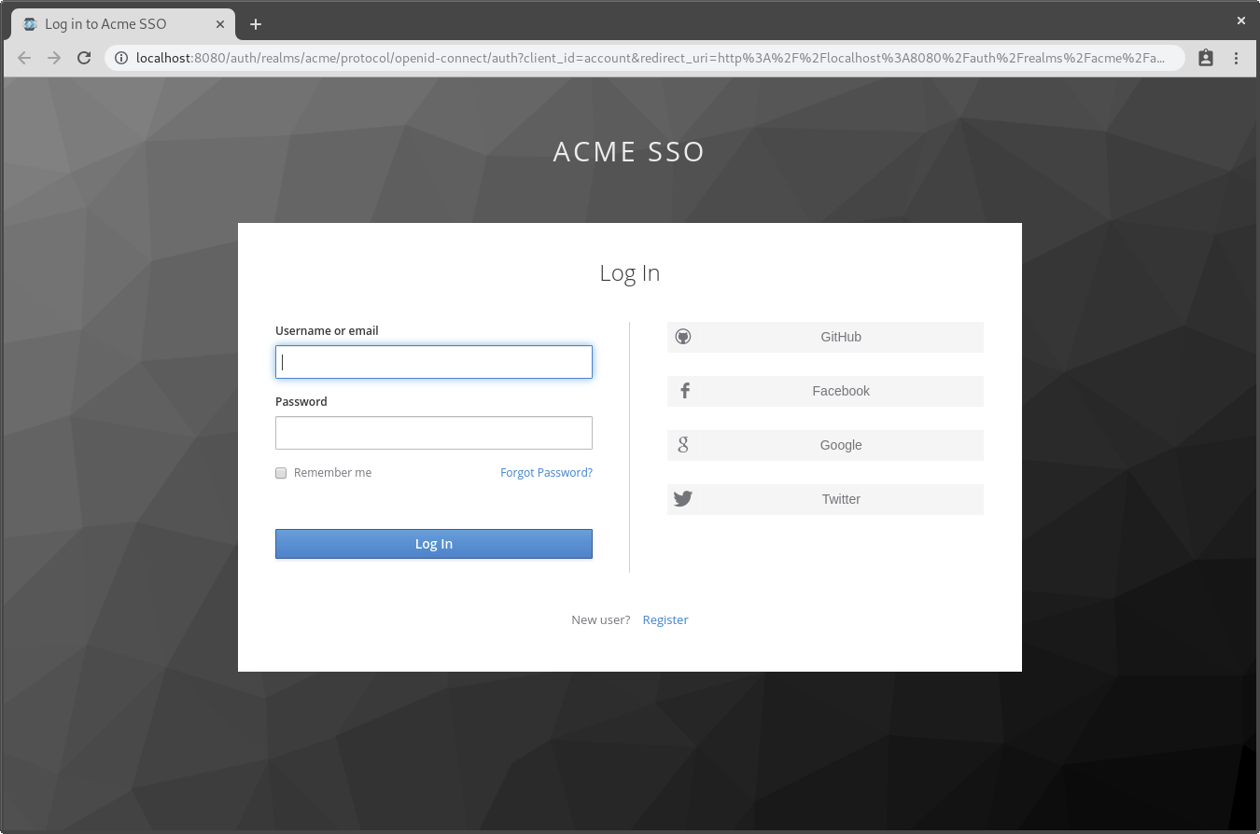
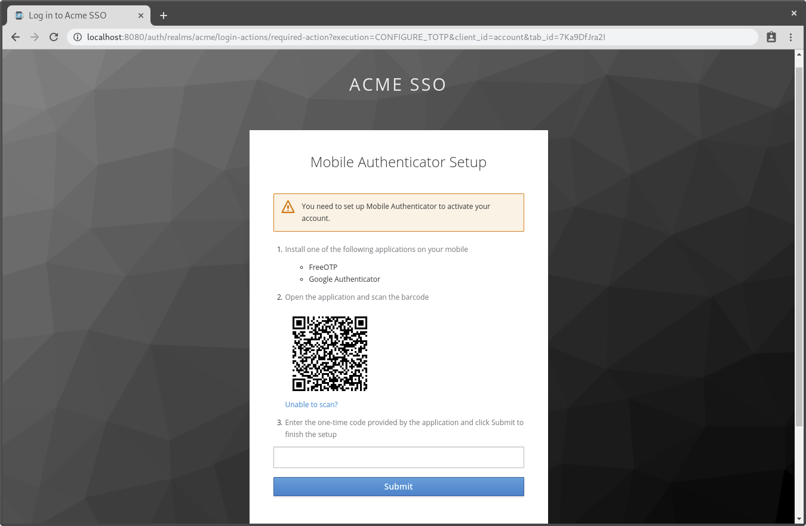
Built-in Login pages (Easily Customized)
What is it?
Notes:
So here is a look from a UI perspective at what the developer has to work with in terms of creating a themed login experience.
Also looking at user registration for OTP MFA.
We are in the process of introducing further authenticator support for WebAuthN.And also there is a demo of the modernization effort with this current UI

Slide 11
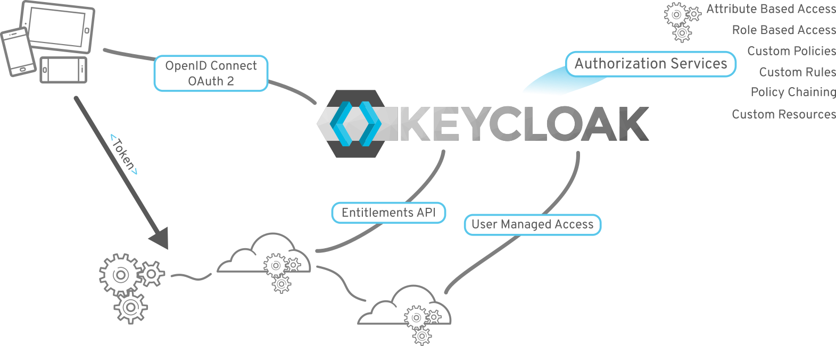
Centralized Authorization
What is it?
Notes:
Second is AuthZ via OIDC and Outh 2.
So now once Autheticated you can define in the token what a particular user has access to
In a fine grained manner based on defined roles, defined groups, attributes, custom policies, etc.

Slide 12
Keycloak Concepts
Core Concepts
Identity Manager (IdM) / Identity Access Manager (IAM)
Controls information about users and services
Keycloak is an IAM, can be an IdM
Identity Provider (IdP)
Service that can authenticate a user
Keycloak is an IdP
Service Provider (SP)
System that receives & accepts authentications (SAML assertions, OIDC tokens, etc)
Identity Provider Federation / Identity Brokering
Mechanism to delegate authentication to one of more IdPs
Social login via Facebook, Google, GitHub, etc
Keycloak can delegate authentication to any other OpenID Connect or SAML 2.0 IdP
Identity Provider Mapper
Ability to map incoming tokens/assertions to user & session attributes for propagating identity information
Notes:
For SAML 2.0, supports both POST & redirect scenarios

Slide 13
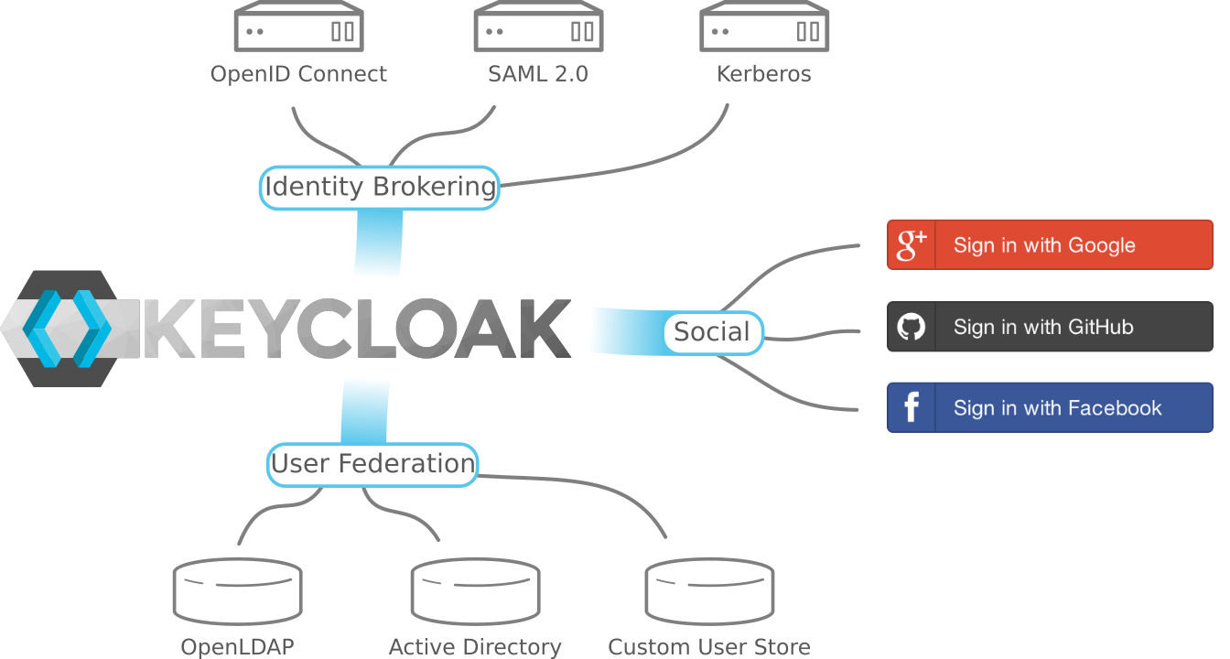
User Federation
What is it?
Notes:
To achieve AuthN KeyCloak/RH-SSO provides full integration
With other existing identity sources such as Active Directory via federation and allows for identity brokering to other OIDC SAML or Kerberos based systems.
It also has built in support via OIDC for integration with existing social login platforms

Slide 14
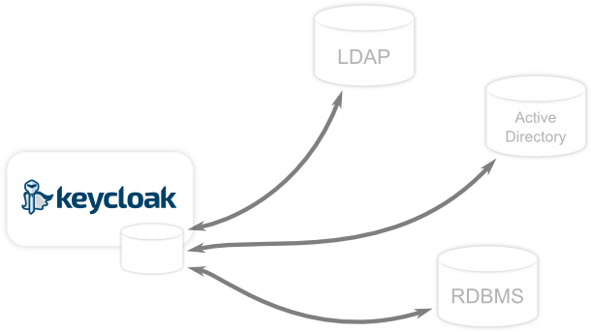

User Storage Federation
Core Concepts
Keycloak can federate multiple external user databases
LDAP/Active Directory most common
Keycloak maintains its own caches & relational identity database
Always imports users from external providers into local storage
How much data depends on the underlying federation plugin
Additional fields/features can be added to external user stores
Keycloak provides API for creating custom plugins for user federation

Slide 15
Keycloak Concepts
Core Concepts
Realm
Manages a set of users, credentials, roles, & groups
Users belong to realms
Realms are isolated from each other
Realms can only manage & authenticate users they control
Client Adapters
Plugins installed to be able to communicate & be secured by Keycloak [1]
Java, JavaEE, Spring, Node.js, Javascript, etc
User Federation Provider
Store & manage users
Validate credentials from external stores & pull in identity information
LDAP, Active Directory, Kerberos, custom, etc
[1] Keycloak Supported Configurations: https://access.redhat.com/articles/2342861

Slide 16
Keycloak Concepts
Core Concepts
Users
Entities that are able to log into your system
Can have attributes associated
email, username, phone number, etc
Credentials
Pieces of data that Keycloak uses to verify the identity of a user
Passwords, one-time passcodes, digital certificates, etc
Roles
Type of category of a user
Applications can assign permissions to roles rather than specific user
Roles can be composed to contain other roles
Typically used to manage applications & services
Groups
Users can be grouped together
Users in a group inherit the attributes & roles of the group
Typically used to manage users

Slide 17
Keycloak Concepts
Core Concepts
Authentication Flows
Workflows a user must perform when interacting with certain aspects of a system
Registration flows, login flows, credential reset flows, etc
Registration Flow
Workflow a user must perform when a realm allows self-registration
Can define what profile information a user must enter
Can require additional identity validation steps
OTP, OOB, reCAPTCHA, etc
Login Flow
Defines what types of credentials are required to perform a login
Username/password, MFA, etc
Required Actions
Actions a user must perform during the authentication process
Interval-based and/or scheduled password reset, etc
Notes:
Voravit - Ask about flow that applications need to managed

Slide 18
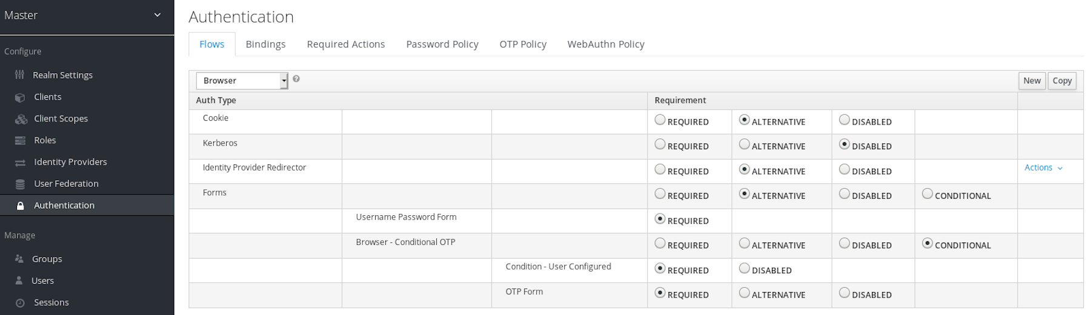
Keycloak Authentication Flows
Core Concepts

Slide 19
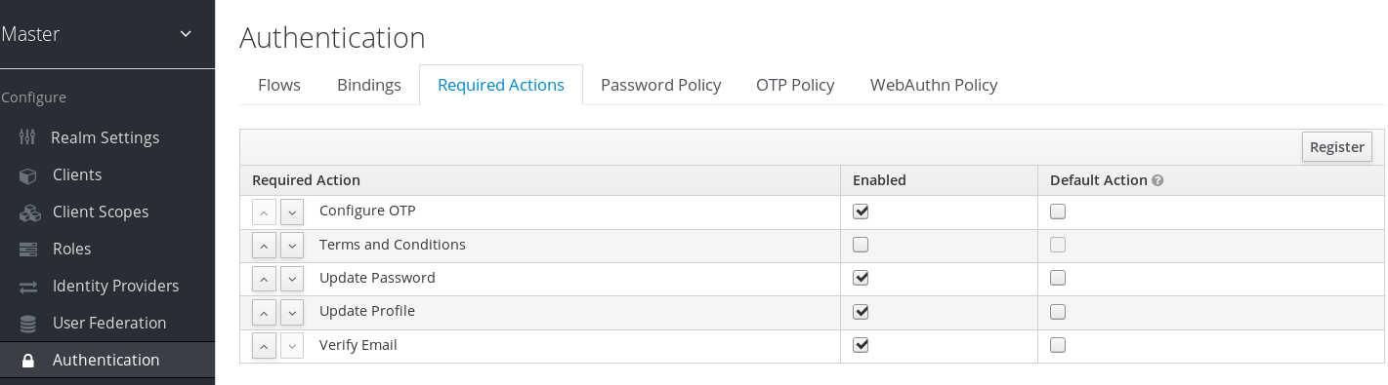
Keycloak Required Actions
Core Concepts

Slide 20
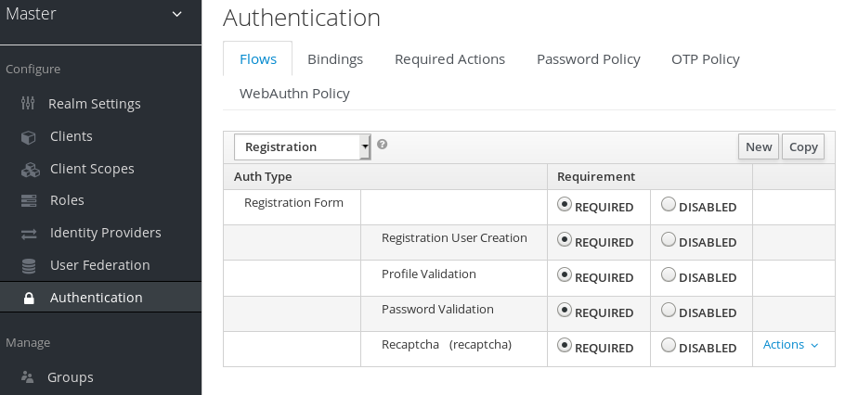
Keycloak Registration Flows
Core Concepts

Slide 21
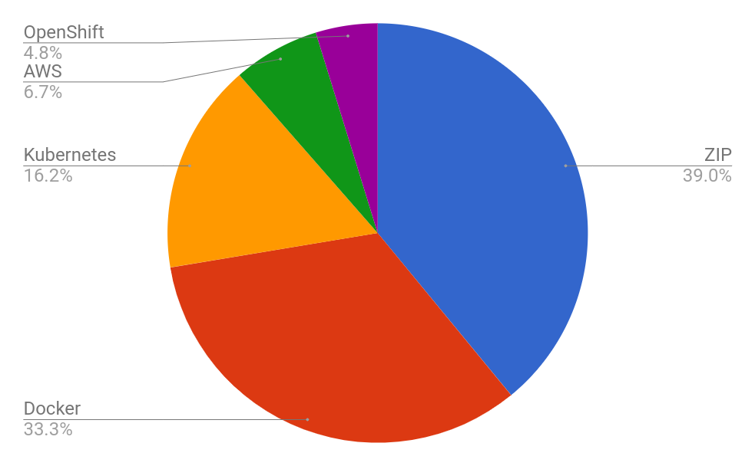
Minimum System Requirements
Architecture
Java 8
zip/gzip/tar formats for standalone or BYO container
512M RAM
1G disk space
Clustering capabilities
https://access.redhat.com/solutions/3217681
Notes:
RH-SSO is an HTTP service that runs on a Java App Server, with its implications:
Secured and tuned similar to others Java appservers: heap, number of threads, database connection pools.
Secured and tuned similar to others HTTP and network services: load balancers (hardware/software), TCP/IP OS settings, TCP/IP network settings
Tested databases
https://access.redhat.com/articles/2342861#Int_7_3
MariaDB & Gallera
MySQL
Oracle MS SQL Server
Postgres
infrastructure needed for RH-SSO will depend on (no 1-size fits all)
Number of users
Used protocols (SAML heavier than OIDC)
Expected logins in delimited amount of time
Network infrastructure and topology

Slide 22
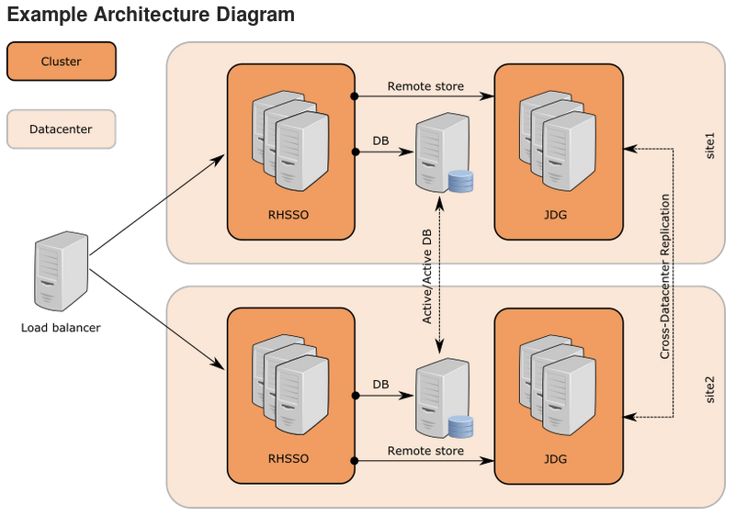


Deployment View
Architecture
https://access.redhat.com/articles/2342881
Notes:
RH-SSO is an HTTP service that runs on a Java App Server, with its implications:
Secured and tuned similar to others Java appservers: heap, number of threads, database connection pools.
Secured and tuned similar to others HTTP and network services: load balancers (hardware/software), TCP/IP OS settings, TCP/IP network settings
infrastructure needed for RH-SSO will depend on (no 1-size fits all)
Number of users
Used protocols (SAML heavier than OIDC)
Expected logins in delimited amount of time
Network infrastructure and topology

Slide 23
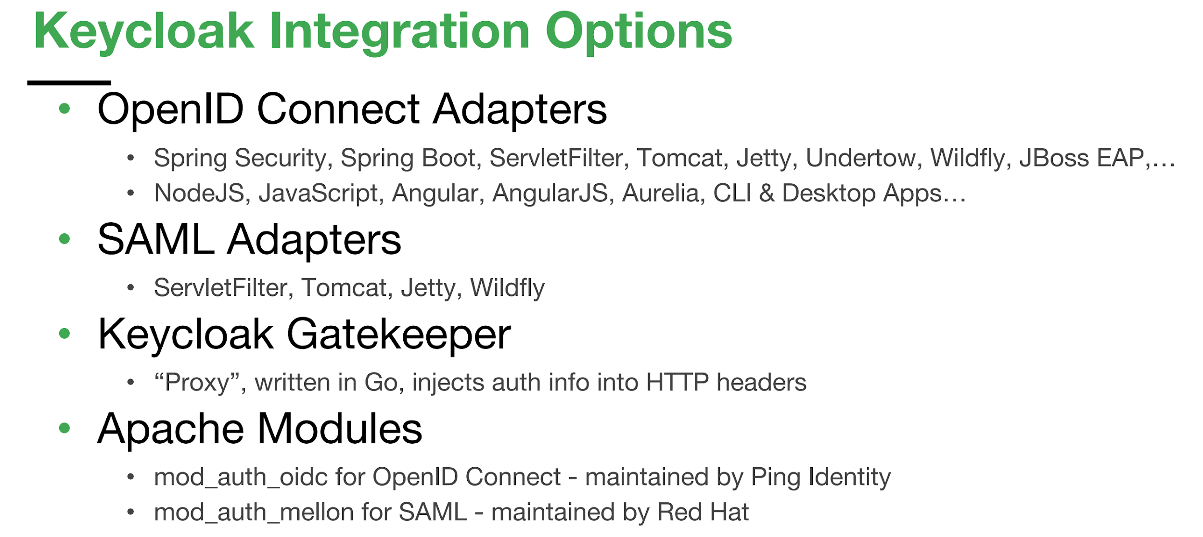
Keycloak Integration Option

Slide 24



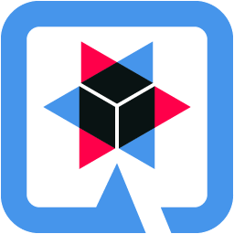

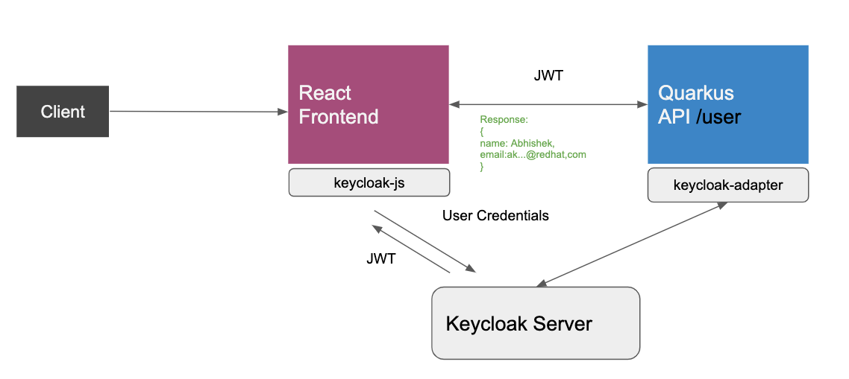
Keycloak OpenID Connect Adapter
Adding authentication to your Web applications with Keycloak

Slide 25
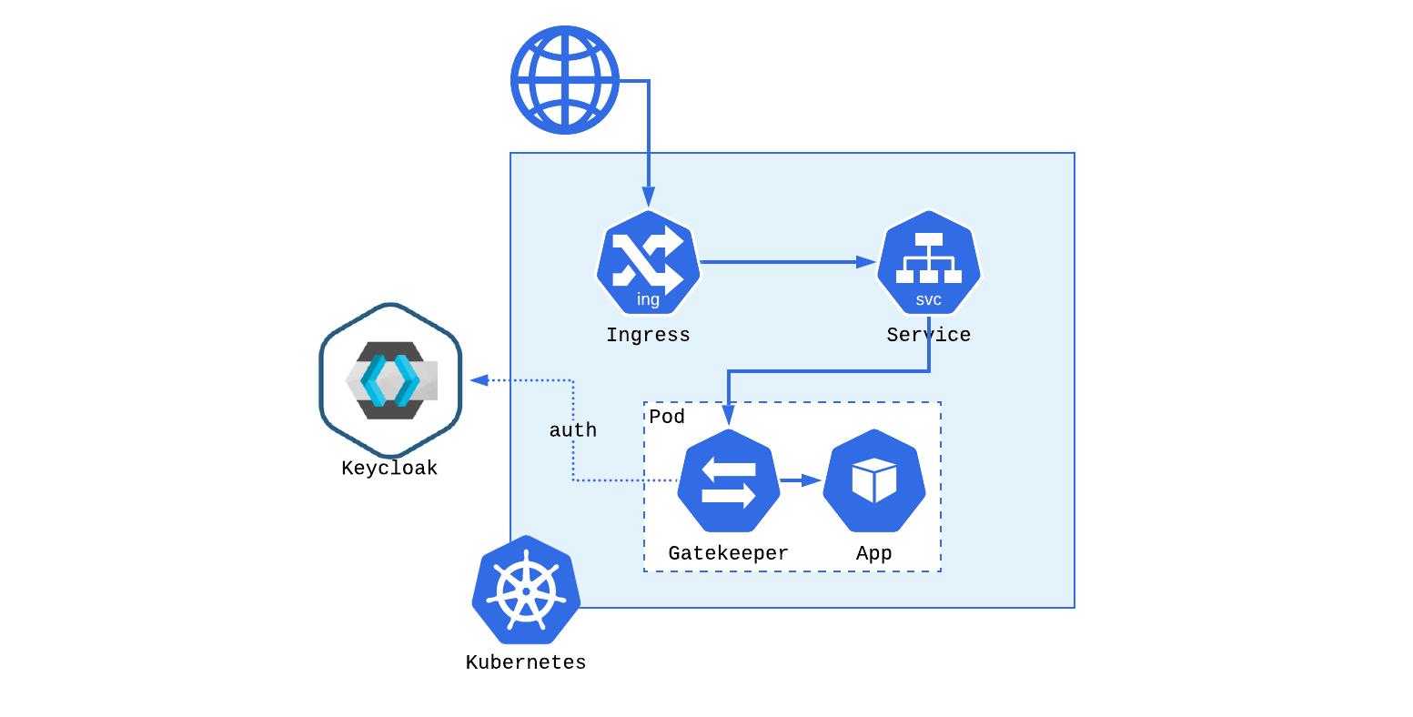
Keycloak Gatekeeper
Adding authentication to your Kubernetes Web applications with Keycloak

Slide 26
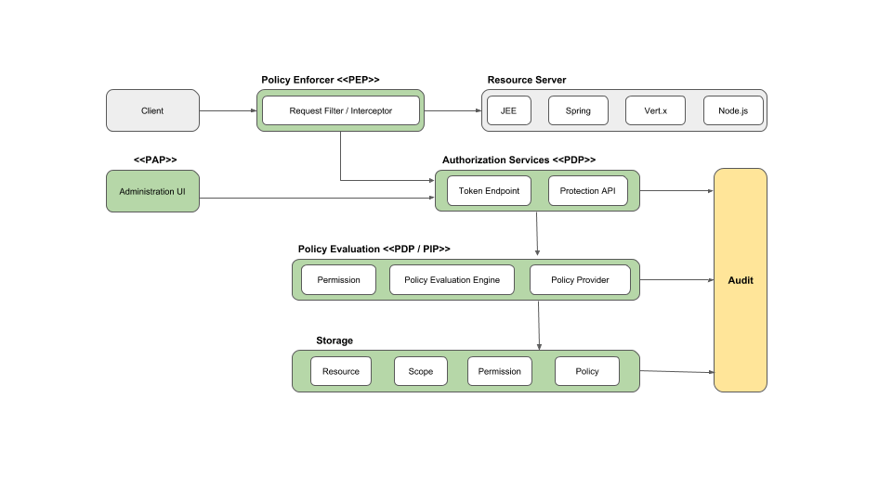
Authorization Mechanisms
Attribute based (ABAC)
Role-based (RBAC)
User-based (UBAC)
Context-based (CBAC)
Time-based
Rule-based
JavaScript or Drools
Custom access control mechanisms (ACMs) via Policy Service Provider SPI
https://access.redhat.com/documentation/en-us/red_hat_single_sign-on/7.3/html-single/authorization_services_guide/index
Notes:
Voravit - ask about RBAC vs CBAC

Slide 27
DEMO Time!
https://github.com/akoserwal/devnationtt-vue-keycloak

Slide 28

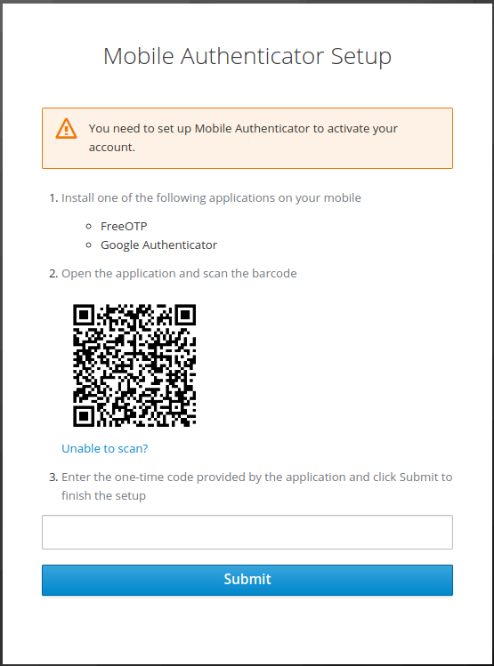
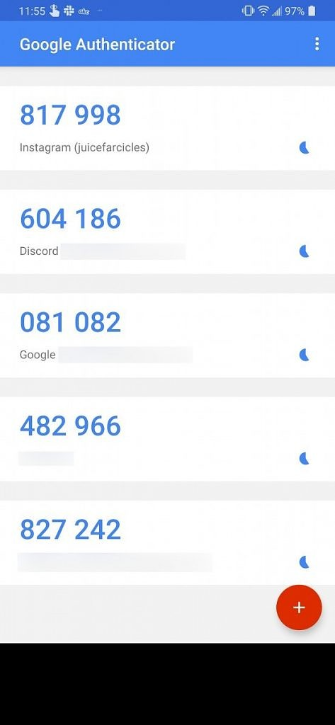
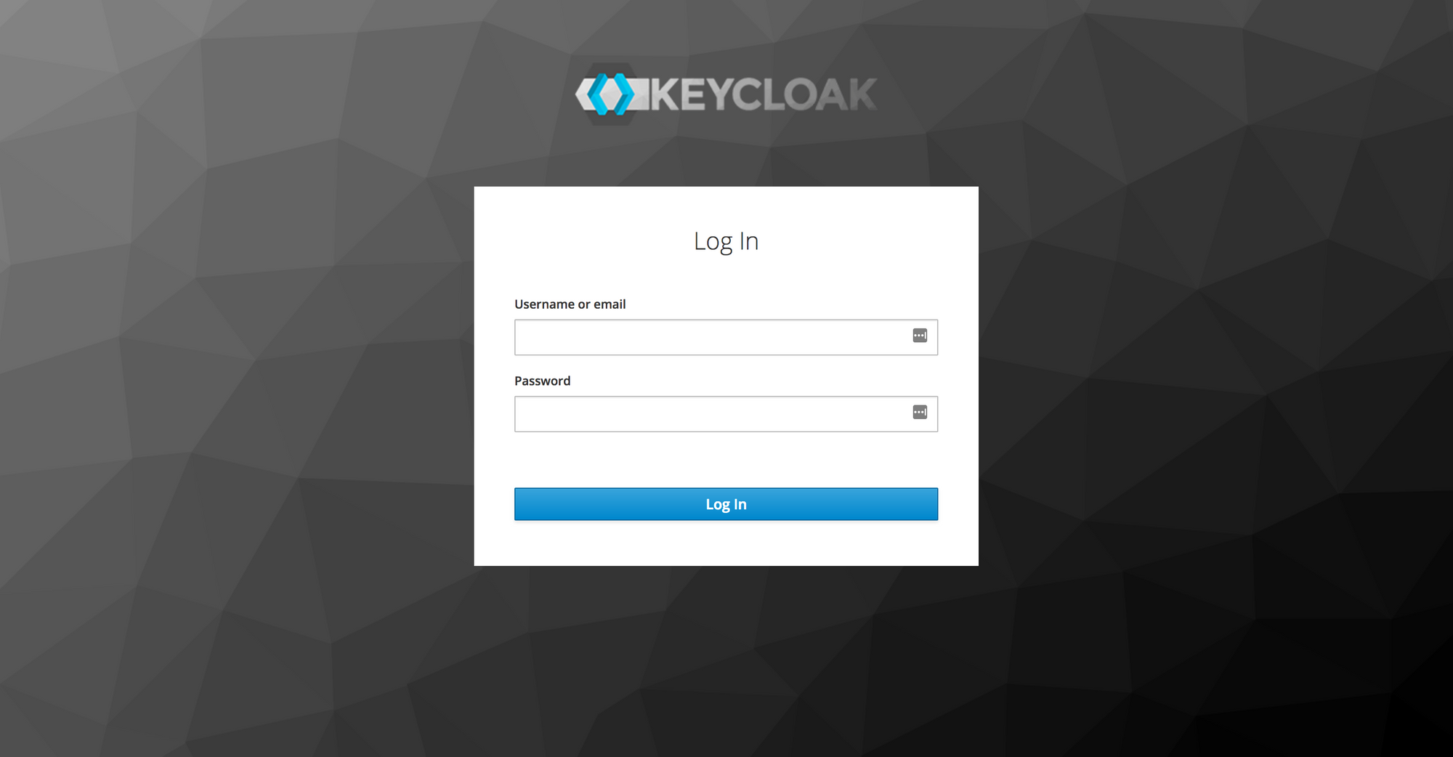
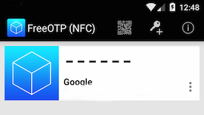
Demo web authen with OTP

Slide 29
How to Secure (Micro)Services?

Slide 30
Secure Microservices with OpenID Connect
Notes:
Voravit - ask about secure backend app

Slide 31
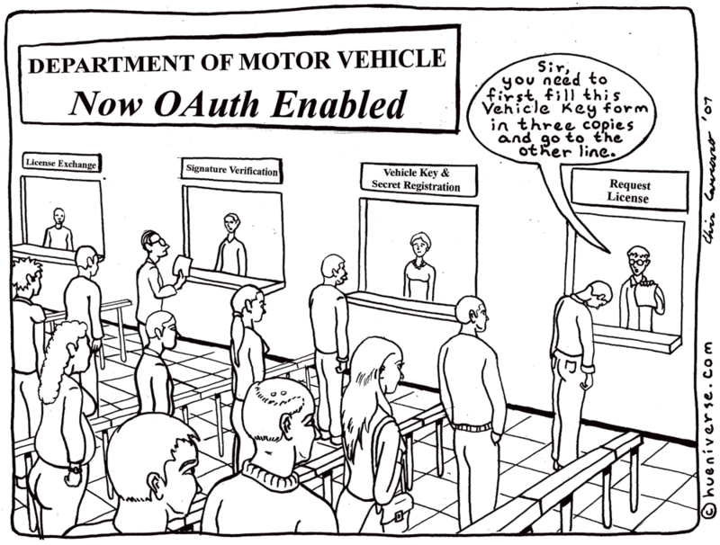

Slide 32
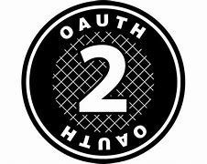
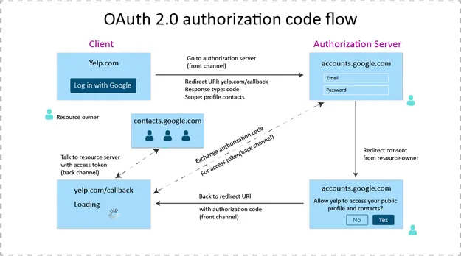
Origin Security with OAuth 2.0
Created to solve the delegated authorization problem
E.g. use case: Yelp would like access to your Google contacts
Resource owner (user)
Client (Yelp app)
Authorization server (Google authorization server)
Resource server (Google API server)
Authorization grant (User says Yes)
Redirect URL (callback)
Access token (Yelp needs key to access data)

Slide 33
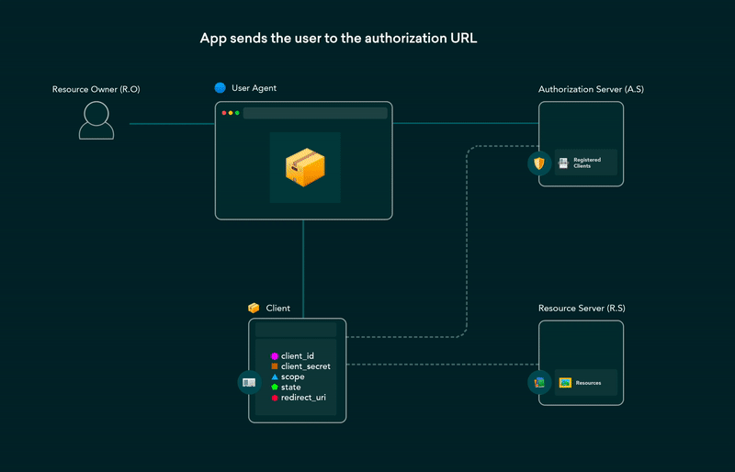
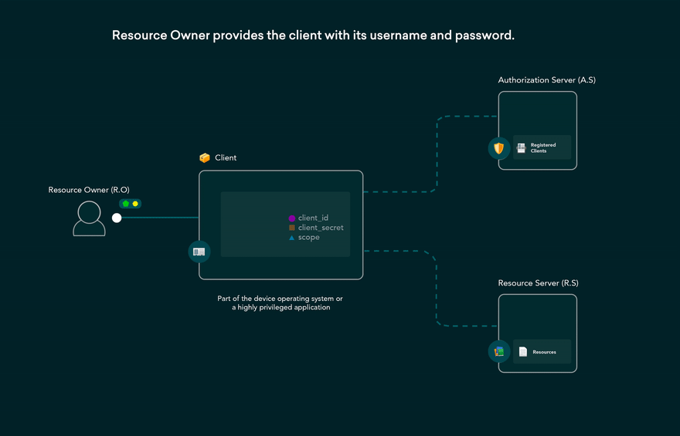
OAuth 2.0 Flows
Authorization code (front & back channel)
The most secure and used where a user logs into Identity server and grants access to Application to retrieve their data
Implicit (single page app; no back channel)
User logs in but secret is not passed
Resource owner password credentials (only back channel)
Application, username and password data is passed in a single request for an Access Token
Client credentials (only back channel)
Only Application data is passed in a single request for an Access Token
Authorization Code Grant flow
Client Credentials Grant flow
https://dev.to/hem/oauth-2-0-flows-explained-in-gifs-2o7a

Slide 34
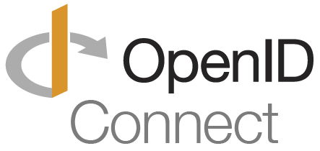
What is OIDC?
OAuth 2.0 Issues
OpenID Connect
Designed for authorization flows
Also used initially for authentication
Not a good fit for authN
no standard way of getting user info
every implementation is slightly different
no common set of scopes
Extension of OAuth 2.0
To address authentication use case
OIDC adds
ID token
Userinfo endpoint for get more user info
Standard set of scopes
Standardized implementation

Slide 35
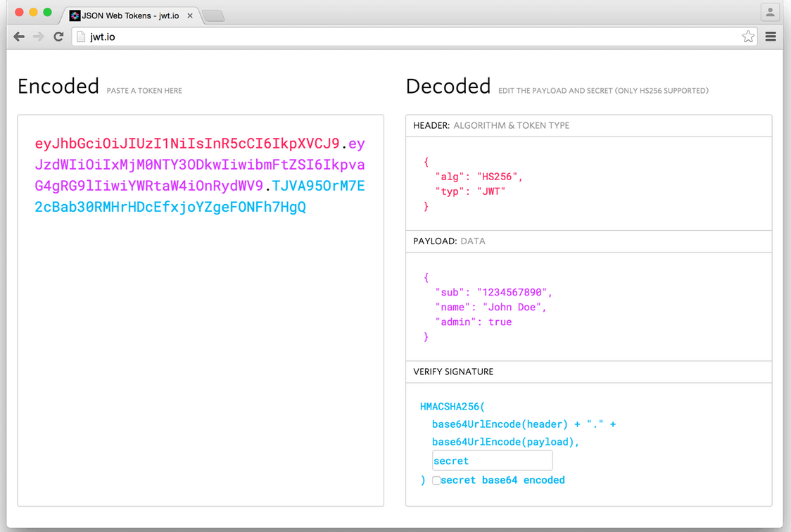
OIDC Profile
OIDC Flow adds a openid scope in addition to the profile
Final step: exchange of authorization code for access token and ID token
ID token is Java Web Token (JWT)
3 parts separated by dots
header, payload, signature

Slide 36



App Retrieves token
OIDC Example
Identity Provider
RH SSO
{username / password}
POST /auth/realms/{realm}/protocol/openid-connect/token
Server Side Applications
Service

Slide 37
RH-SSO Sends Valid Bearer Token
OIDC Example
Identity Provider
RH SSO
HTTP 200 { access_token, token_type, expires_in }
Server Side Applications
Service

Slide 38

App Calls Service With Bearer Token
OIDC Example
Identity Provider
RH SSO
Access Token
Server Side Applications
Service
redhat.com/api/catalog
Header: “Authentication: Bearer {token}”

Slide 39
Token is Verified
OIDC Example
Identity Provider
RH SSO
Access Token
Server Side Applications
API Gateway
Service
Verify JWT
Notes:
It could be the actual service rather than an API Gateway performing these tasks

Slide 40
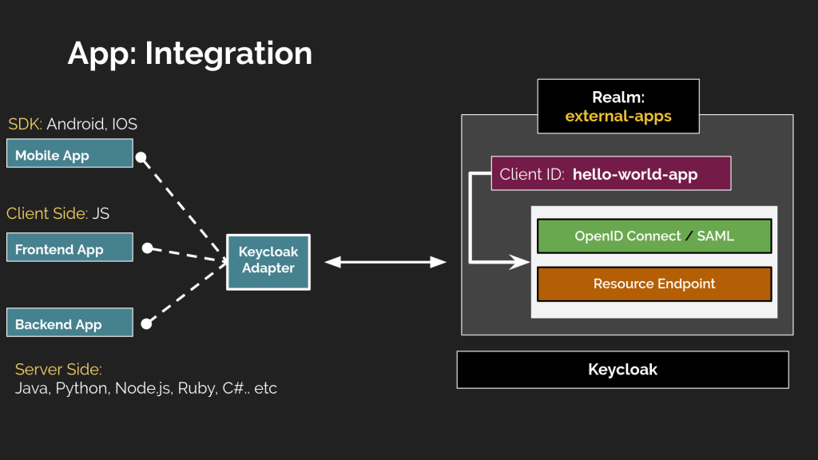
Keycloak OpenID Connect Adapter

Slide 41
DEMO Time!
OIDC with grant type password
https://quarkus.io/guides/security-keycloak-authorization

Slide 42
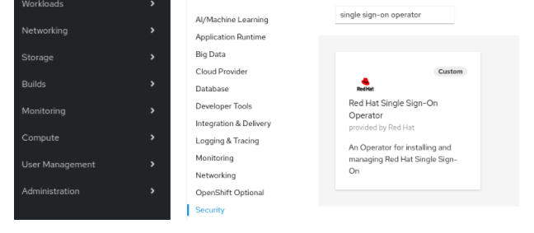


KeyCloak & Red Hat SSO
Red Hat SSO (current version 7.4)
Include in Red Hat Runtimes, Integration and Process Automation
Include in Red Hat OpenShift Platform

Slide 43
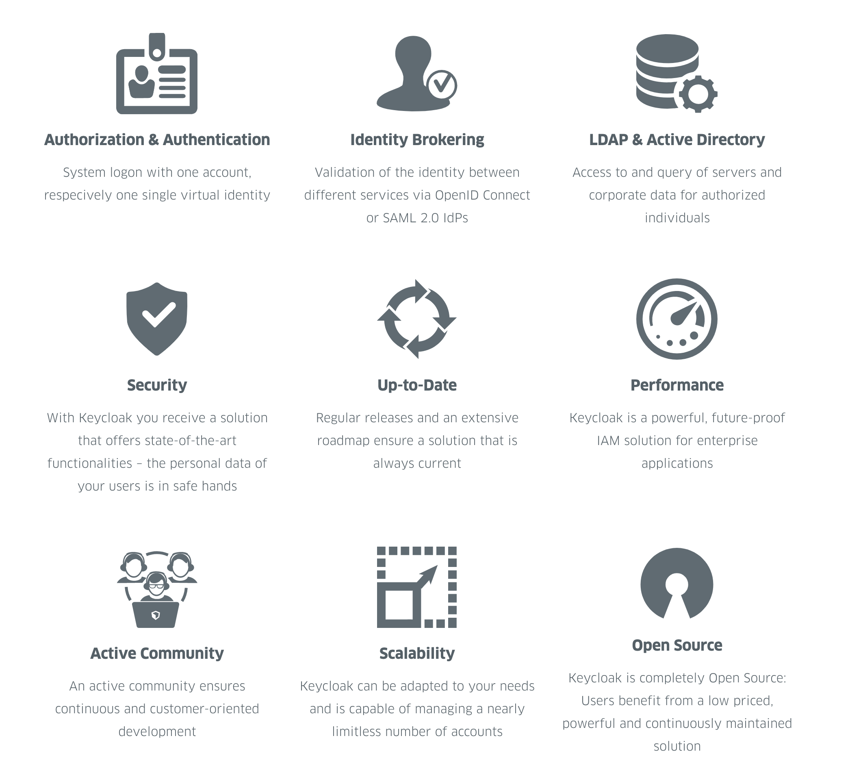
Summary

Slide 44
Thank you
Red Hat is the world’s leading provider of enterprise open source software solutions. Award-winning support, training, and consulting services make
Red Hat a trusted adviser to the Fortune 500.

